Slide 1
TPP Pediatrician Meeting
The Sofia Foundation for Children’s Safety
4/26/18

Slide 2
OBJECTIVES
1
Bag in the Back: An Awareness Campaign
2
Vehicular Heatstroke and Leaving Children Unattended in the Car: What we know today
3
Encourage the Pediatrician Community to Help Us Amplify and Advocate for the Message

Slide 3
Bag in the Back a Habit that Save Lives
Bag in the Back, a Habit that Saves Lives
To instill the habit of always putting an essential item in the backseat of the
car with the hope of minimizing the number of children that are unknowingly
left in the car seat and vehicular heatstroke

Slide 4
What does the Bag in the Back Habit teach you ?
It is a habit that every person who is driving a child in a car seat should practice.
The habit teaches caregivers to put an essential personal item i.e., a purse, cell phone, a shoe, the back pack, etc., in the back seat of the car below the car seat.
If practiced properly, it will ensure that every time the caregiver turns off the car engine, he/she will have to open the back door to pick up the personal item that was placed there.
This habit will force the caregiver to open the back door every time he/she gets out of the car.

Slide 5
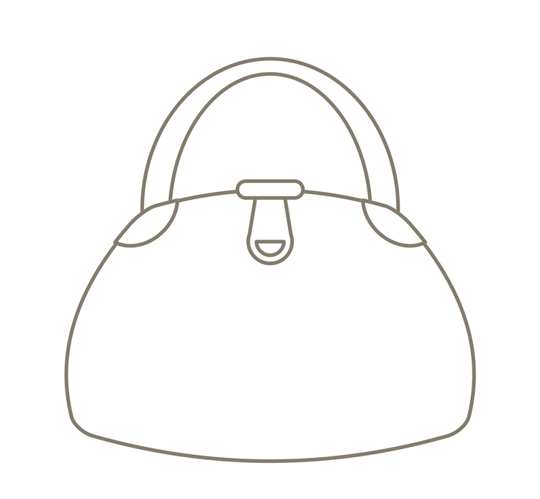
What is Considered an Essential Personal Item?
An item that you use every day and if it is missing you will be forced to go back to the car to continue your daily activities.
Examples of Essential Personal Items

Slide 6
Who Should Adopt This Habit?
Parents
Caregivers
Grandparents
And anyone who takes care of a child that is below the age of 5, i.e., aunts, baby sitters, bus drivers, day care administrators and teachers.

Slide 7
Baseline Survey
Understanding how often this can happen and how much awareness there is about leaving your child unknowingly in the car and vehicular heatstroke
WHO PARTICIPATED
949 adults participated
423 of the responders had children between the ages of 0 to 3
Less than <1 year | 1-2 years | 2-3 years | 3-4 years | 4-5 years | 6+
170 | 122 | 131 | 89 | 116 | 249

Slide 8
Sources of Information:
Vehicular Heatstroke versus SIDS
Who has talked to you about this?
SIDS
Vehicular Heatstroke
* Among parents with a child 3 years or younger
The main source of information for bag in the back habit are media, website blogger, or a friend.
Only 5% of parents got the bag in the back message from their pediatrician/doctor. This is a critical discrepancy given that pediatricians are the most trusted source of information on health and parenting (M. Bailey, 2008).

Slide 9
Differences in Awareness
Back is Best a Sleep Habit
to reduce SIDS
Bag in Back Habit
to reduce leaving your child unknowingly in the car and vehicular heatstroke
* Among parents with a child 3 years or younger

Slide 10
Conclusions
vs.
Awareness is needed
90% of parents received sleep on back message from pediatricians/doctor. Only 5% of parents got the bag in the back message from their pediatrician/doctor.
There is almost a 2x difference in awareness about how to prevent SIDs versus how to prevent vehicular heat stroke.
Almost all parents have been told to put their babies to sleep on their back while only half have been told to put a bag in the back with their child.
Involvement of the medical community

Slide 11
Since 1998, in the US alone, more than 748 children have died due to hot car seat.
Sadly the statistics have remained unchanged with the national average of 37 children dying every year.
The Bag in the Back Campaign was designed to increase awareness about this threat AND to instill a habit of always putting the bag in the backseat
We hope that via this awareness message we will minimize the number of children that are unknowingly left in the car seat AND…
SAVE LIVES!!!
HELP US MAKE A DIFFERENCE
For more information visit www.backintheback.org

